Slide 1

AAMN Future-RN Elementary School Slideshow
Peter Enge, MSN, RN
Andrew Richards, PhD, RN
Joseph Wright, MSN, RN

Slide 2


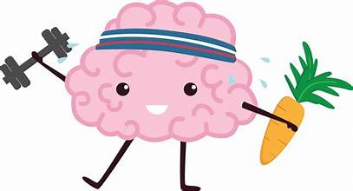
You will be able to recall how Nurses help:
Nurses help you
Nurses help communities
Nurses help teams
Notes:
Objectives for a younger audience

Slide 3
You will be able to recall how Nurses help:
Notice how nurses support activities that help to build strong bodies and health minds.
(hygiene, nutrition, exercise, & mental well-being)
Recognize how nurses collect and communicate vital information that is important to health.
(vital signs, & team communication)
Acknowledge how nurses can improve the health of individuals and the greater community.
(civility, team building, & working together)
Notes:
Objectives for an older audience

Slide 4
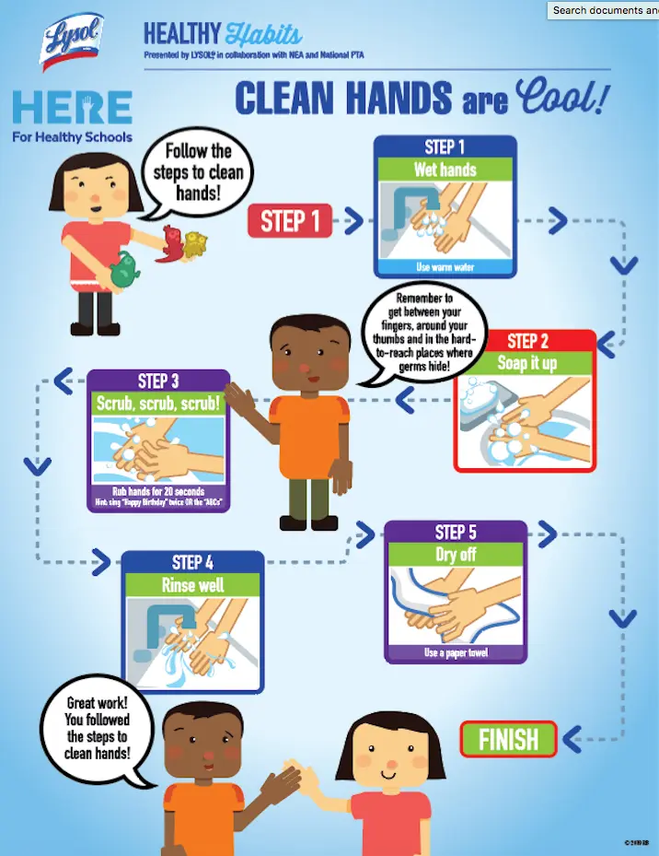
Your Healthy You [Hand Hygiene]
Sharing germs can make our friends sick.
Cough or sneeze in your elbow.
Wash your hands:
After you cough or sneeze
After blowing your nose in a tissue
Before you eat
Before and after using the bathroom
When they are dirty
Don’t forget about using hand sanitizer!
Notes:
Education:
The importance of handwashing and use of hand sanitizer
Objectives: Students will be able to:
express when to wash their hands
Demonstrate how to wash their hands with soap and water and hand sanitizer
Supplies/Materials:
Soap and water
Hand sanitizer
Glow germs or finger paint
Portable black light if using Glow Germs
Hands on Practice:
Explain how washing hands removes germs.
Demonstrate hand washing for at least 20 seconds (while singing ABC’s, Happy Birthday or Twinkle Twinkle little star).
Apply Glow germs or small amount of finger paint to each child’s hands.
Bring each child to the sink and allow them to wash their hands
Have the children examined their hands (in a dark area with the black light if using glow germs)
Have each child demonstrate using hand sanitizer until the hands are dry.
https://www.cdc.gov/clean-hands/about/index.html
https://www.cdc.gov/clean-hands/prevention/index.html
Evaluation:
Visualize student handwashing and use of hand sanitizer

Slide 5
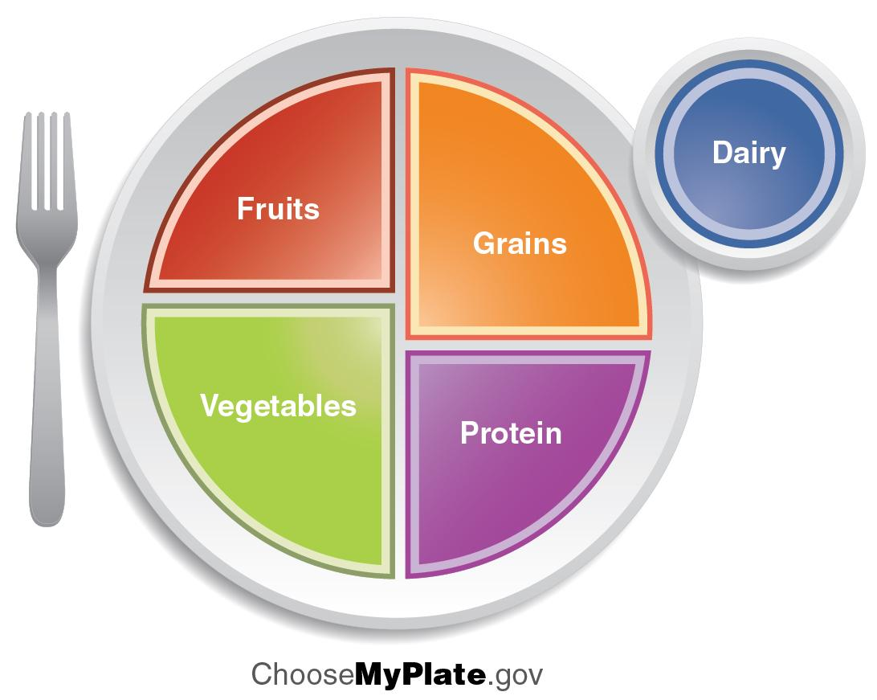
Your Healthy You [Nutrition]
What are the five (5) main food groups?
What vegetables do you choose to help you stay healthy?
What fruits do you choose to help you stay healthy?
What is a protein?
What grains do you choose to help you stay healthy?
What do you think a healthy dairy choice would be?
Notes:
Education: Good food choices for a healthy body
Objectives: Students will be able to:
Identify the five main food groups and name a variety of nutritious examples of
foods in each.
Supplies/Materials:
MyPlate coloring page
https://images.app.goo.gl/cD81F6e4Ww9VU8KH8
Bingo
https://acrobat.adobe.com/id/urn:aaid:sc:VA6C2:2edd966b-3d2d-4a67-9712-d13931930124
Who am I game:
chrome-extension://efaidnbmnnnibpcajpcglclefindmkaj/https://fns-prod.azureedge.us/sites/default/files/tn/sump_level2.pdf
Food Hero Activity Sheets (Crossword puzzles, Connect the dots, etc.)
Activity Sheets | Food Hero
Hands on Practice:
Ask students if they have heard of, can explain, or can identify any of the food groups.
Introduce students to MyPlate and the five food groups (Fruit, Vegetable, Grain, Protein Foods, Dairy)
Explain that the MyPlate icon serves as a reminder that a person should eat foods from the five food groups each day.
Compare and contrast the My Plate to its predecessor My Pyramid
Discuss the importance of physical activity as part of a healthy lifestyle.
Evaluation:
Ask each student to share something new they learned so far about MyPlate and the five food groups.

Slide 6
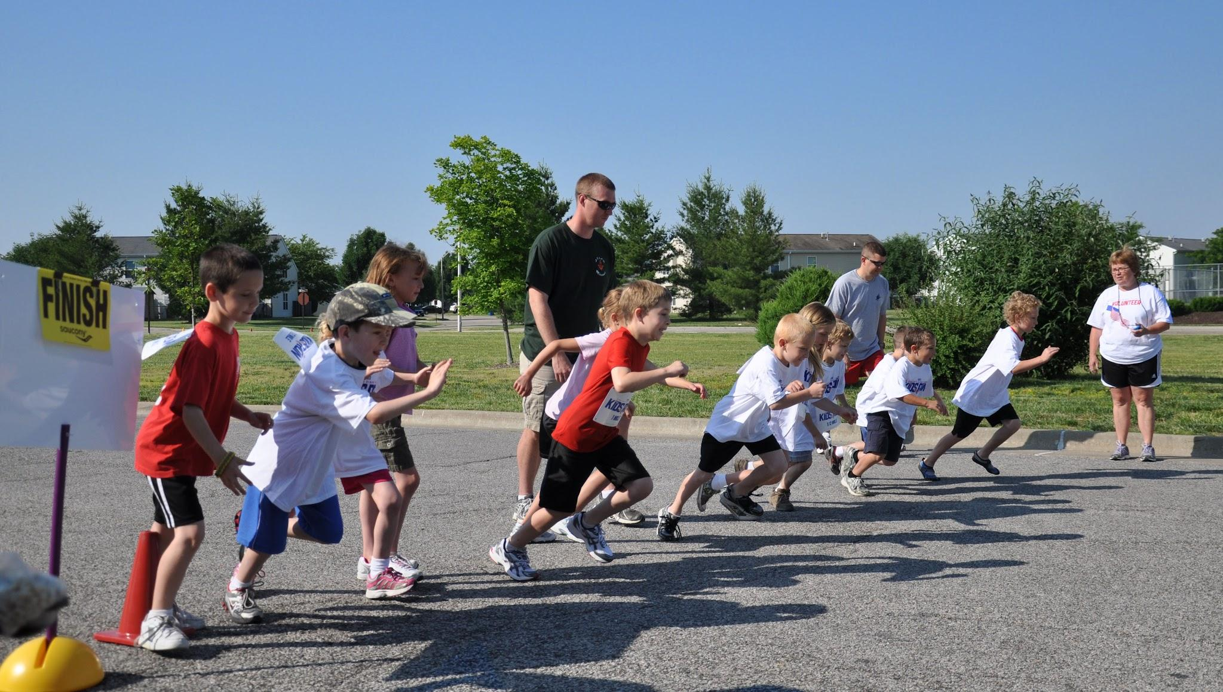
Your Healthy You [Health Promotion - Exercise]
Exercise is good for your heart and mind.
Exercise can put you in a better mood.
Exercise helps you stay or reach a healthy body weight.
What exercises do you like to do?
Notes:
Education: Being active is important for bodies and minds.
Objectives: Students will be able to:
Experience how they feel different before and after physical activity.
Estimate how much daily exercise they get and think of ways they can be more active.
Supplies/Materials:
Flip chart or chalk/dry erase board
Chalk or markers
A blank piece of paper and pencil for each child
The Importance of Daily Exercise for Kids | Health Powered Kids
Hands on Practice:
With the kids sitting quietly, explain that you are going to do a classroom experiment involving exercise.
On the flipchart or whiteboard draw a vertical line down the middle. Label one column “before” and the other “after.”
Ask for words that describe how they are feeling as they are sitting quietly in their seats. Encourage them to pay attention to what kind of mood they are in, what their bodies are telling them, and how much energy they have. They may say things like: calm, tired, antsy, bored, comfortable. Whatever they say is fine as long as they say what they actually feel. Write these words or phrases in the “before” column.
Lead the kids in a variety of exercises, such as high-knee marching around the classroom, sit-ups, push-ups, jogging in place, or jumping jacks. See if anyone has suggestions of activities. Exercise for at least five minutes before having them return to their seats.
Now have them share how they are feeling after exercising. Write those words in the “after” column. They may say things like: alert, awake, happy, full of energy, excited.
Talk about the activity. Reiterate information on the positive health benefits and importance of exercise for kids:
It helps your body maintain overall good health.
It helps build and maintain healthy bones and muscles.
It increases flexibility.
It feels good, if done right.
Ask: How much time should kids exercise each day? How can you get more? Then use the following questions to help them think about their own exercise habits.
How much exercise do you get at school? Prompt them to think about how much time they spend in gym class, and how much time outside for recess. Ask them if that adds up to one hour a day. You may want to add up the amount of time mentioned on the board.
How much exercise do you get when you’re home after school? If young people say that they don’t get much exercise after school, ask them what they do instead of exercise. Ask what their favorite exercise is and plan how they can do more of it. They could turn off the television after 7 p.m., encourage the family to go on a walk before or after dinner, or go outdoors and play with their friends.
What about exercise on the weekends? Ask the kids to make a list. Make sure they remember things like soccer, dance, etc., in addition to playing outside with friends. In fact, it can be anything that involves moving your body, like going for a bike ride, walking the dog, running, helping in the yard, ballet class, soccer practice, gym class—anything that gets your body moving. After the kids make their lists, ask them to write downtimes during the day that they can add these exercises to what they’re already doing so that they reach one hour a day.
Evaluation:
Children can create their own lists of activities they can do.
Children can create an activity chart or diary to keep track of their activity and progress

Slide 7
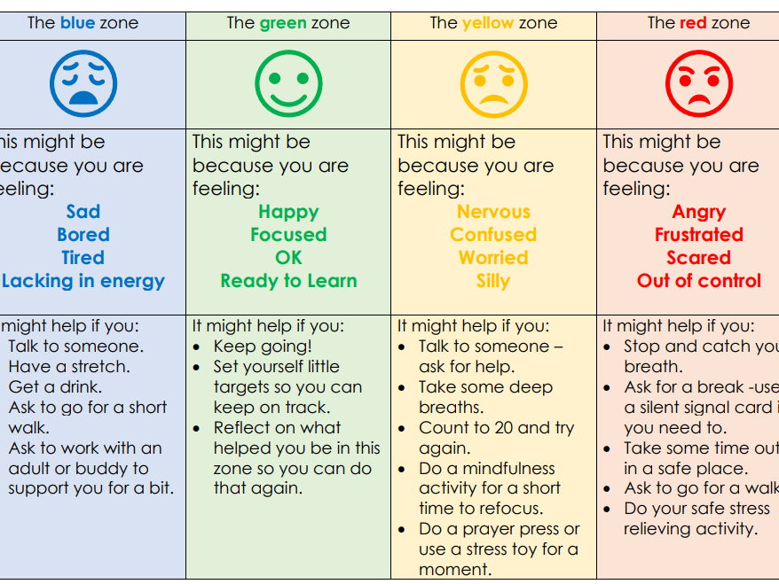
Your Healthy You [Regulate Emotions]
What are the different emotional zones and colors?
What are the different types of emotions that match the colors?
Name an activity that could be done in each zone that matches a feeling?
Notes:
Education:How to self regulate when we are nervous, angry or sad?
Objectives: The students will be able to identify their emotions and learn techniques to use to self regulate.
GoNoodle Breathing Exercises quick brain breaks to model self regulation
Self-Regulation Strategies for Children | Twinkl - Twinkl resources to help with self regulating techniques
Supported Self-Regulation Posters | Teaching Resources access to color chart
Supplies/Materials:
Teachers can utilize the color chart to help identify the different feels their students may be experiencing and strategies on how to handle each emotion.
Red and green construction paper, access to video
Hands on Practice:
Use the link below to access the slide show followed by a game and relaxation techniques. Before the game begins, give each student a red and green piece of paper, while the video is playing ask the student to hold up the green paper for good choices and the red paper for bad choices.
Bing Videos
Evaluation:
Students will be able to correctly identify good and bad choices during the game portion of the activity.

Slide 8


How Nurses Help [Overview of the Profession]
Nursing: an educated and noble profession dedicated to helping people
Notes:
Nursing is a highly respected and dignified profession. Become a nurse after graduation of high school with two years of training.
For 23 consecutive years, nursing has been ranked the most honest and ethical profession (Gallup poll, 2024).
Nurses make up the largest percentage of the healthcare workforce and are crucial in obtaining and relaying information. Nurses communicate with other multiple disciplines (physicians, physical therapy, respiratory, dietary, occupational therapy, pharmacy, social workers, and other healthcare professionals to ensure the best results are obtained for patients and their families.
Nursing is a rewarding career that is full of possibilities and opportunities to learn.

Slide 9

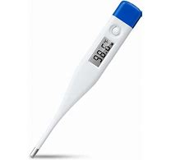

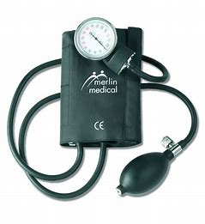
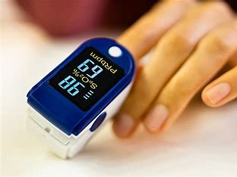
How Nurses Help [Overview of the Equipment]
Tools used in the Profession
Notes:
Hands-on practice - Demonstration and application of the stethoscope, thermometer, BP cuff, scale, pulse ox probe, etc. Nurse use these instruments to gain information needed to help make decisions.

Slide 10
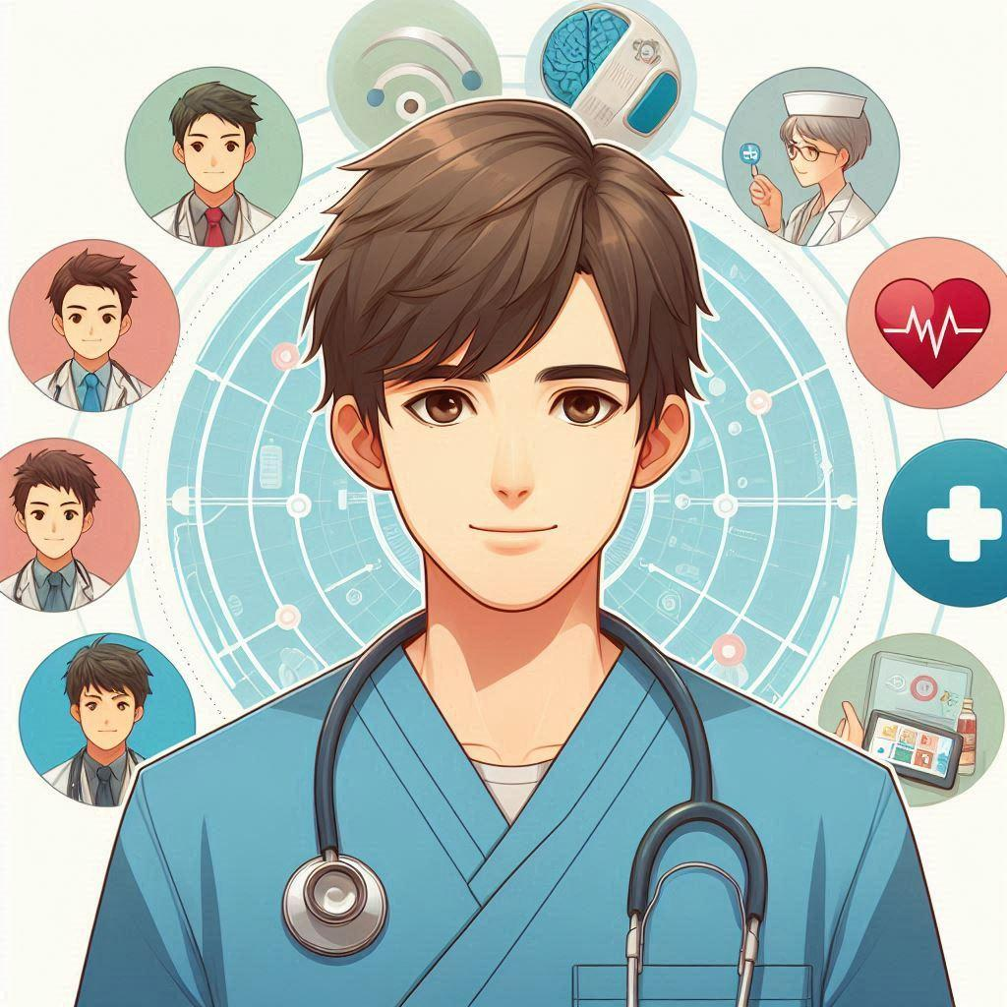

How Nurses Help [Communicating Information]
How do nurses keep you healthy?
Nurses
Coordinate care
Relay information
Record findings
Educate others
Engage in research
Provide comfort
Notes:
Evaluation - [describe how students will show/know understanding and application of education]
Student activity: Participate in an SBAR (closed loop communication game). Monitor progression as it continues through the chain of participants.

Slide 11
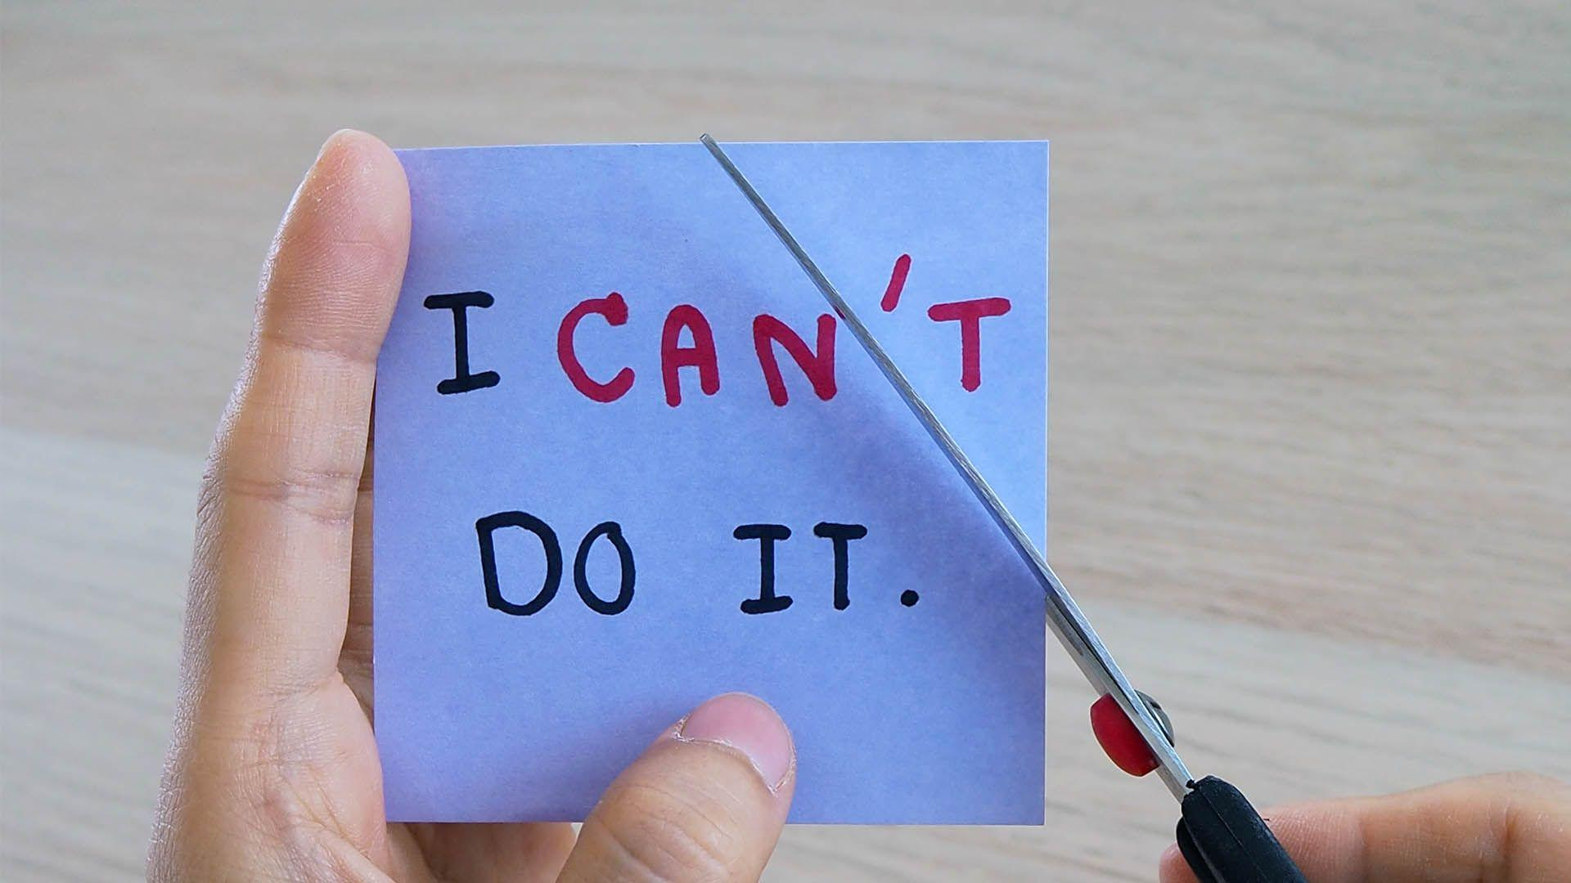
Your Healthy Community [Positivity Activity]
Nurses help improve health by acknowledging problems.
What words would you use to describe someone you like?
What words would you use to describe yourself?
How can positive words help everyone feel better about themselves?
Notes:
Positivity Activity
Education
Supplies (giant sticky-notes, small sticky-notes, crayons, & stickers)
Hands-on practice - place giant sticky-notes around the room. Pass out sticky-notes and crayons. Ask children to draw/write/decorate something positive about themselves and place it on the giant sticky-note.
Evaluation - Smiley face rating of session

Slide 12
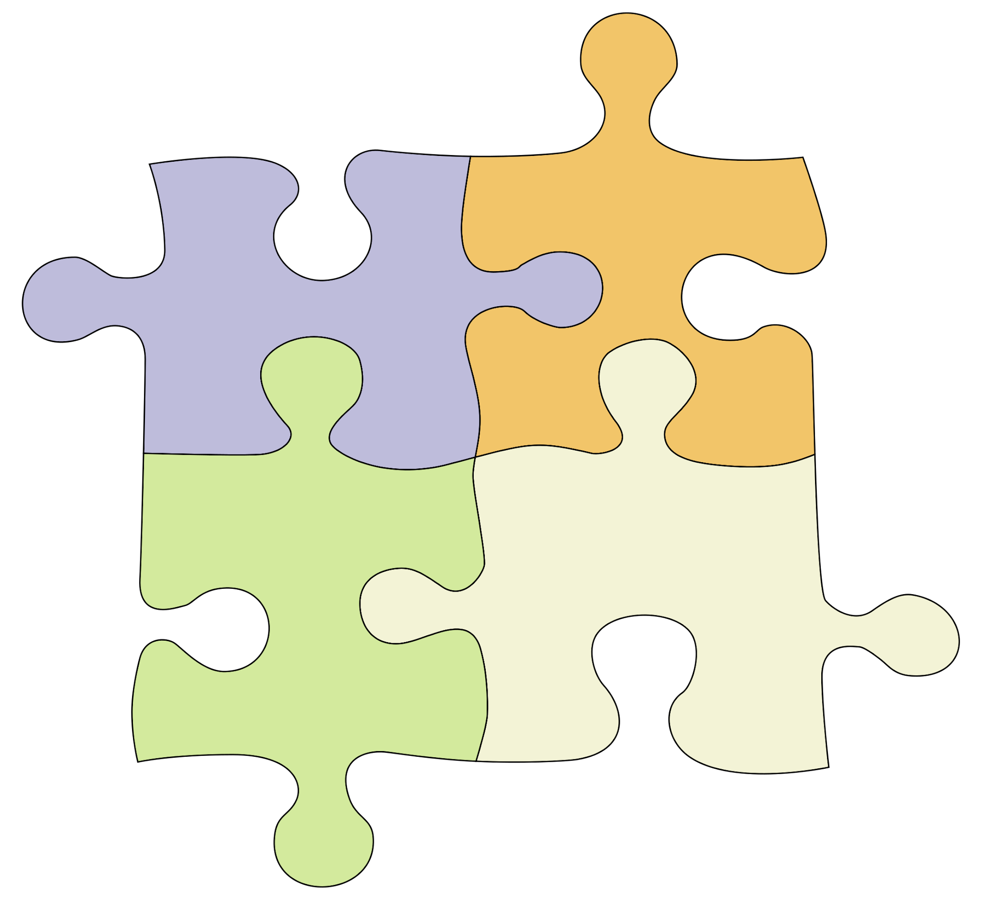
Your Healthy Community [Teamwork]
Nurses help improve health by solving problems.
Have you ever felt like something was too BIG to accomplish alone?
How did you feel when you were part of a team?
What words would describe your feelings after something BIG was accomplished as a team?
Notes:
[TEAMWORK]
Education -
Working Together - [TBA]
Supplies/Resources -
Working Together - several large piece puzzles (100 pieces)
Hands-on practice -
Working together - students complete a task together (puzzle, challenge, etc.)
Evaluation - Smiley face rating of session

Slide 13
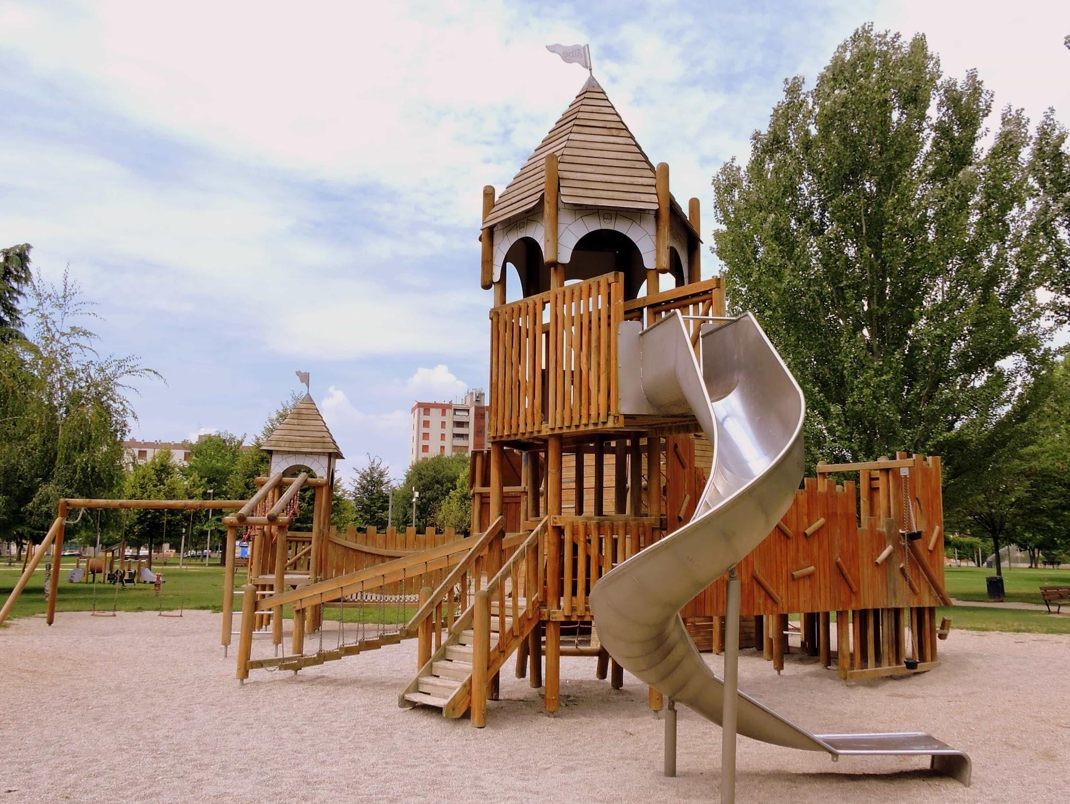
Your Healthy Community [Communication]
Nurses help improve health by finding solutions.
How do you find your way to a destination?
What obstacles did you find along the way?
What words would describe your feelings after you found your way to the place you were seeking?
Notes:
[COMMUNICATION]
Education -
Communication - [TBA]
Supplies/Resources -
Communication - blindfold and obstacles (tables, desks, chairs, etc)
Hands-on practice -
Communication - blindfold student, classmates give directions to help cross room (obstacles).
Evaluation - Smiley face rating of session

Slide 14

Questions/Discussion

