Slide 1

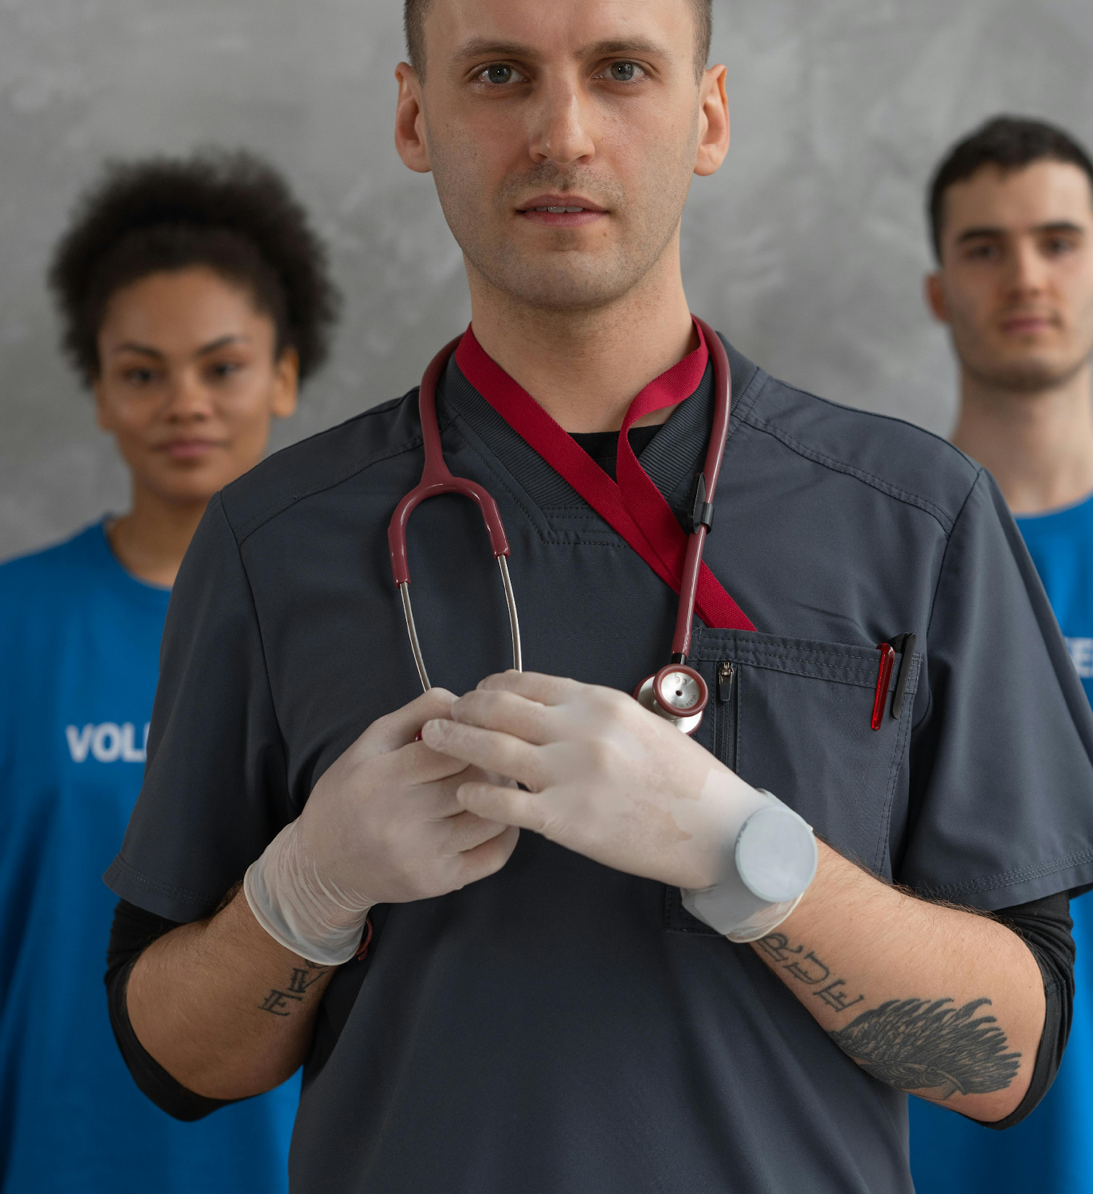
AAMN Future RN: High School Slideshow
MARINO CASTILLO DE LA CRUZ
DANIEL MISA, MSN, RN
Notes:
Self intro,
Name, role, experience
Purpose of presentation; introduce the field of nursing, its impact and how to pursue the career

Slide 2
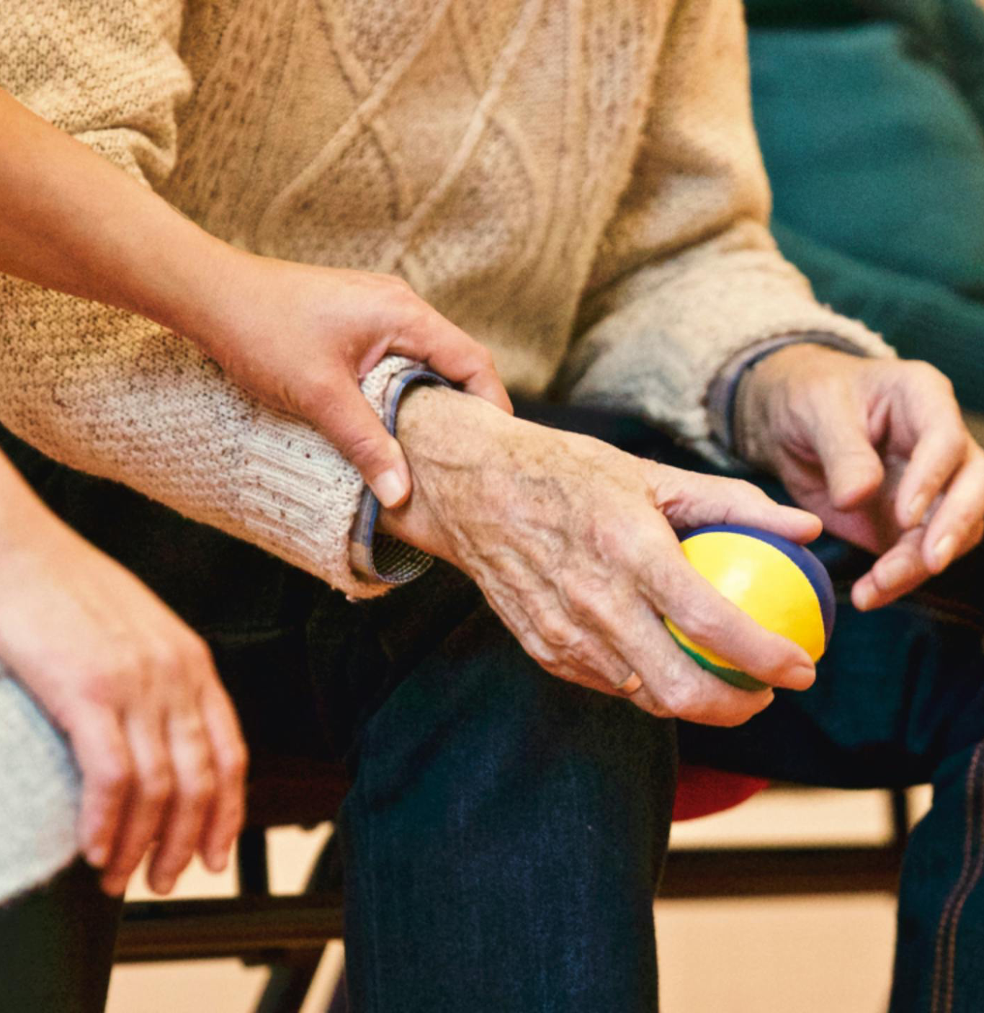
What is a nurse?
A person formally educated and trained to take care of the sick; the bridge between the patient and medicine.
Core responsibilities/skills
  Monitoring patient health
  Administering medications
  Educating patients and families
  Collaborating with doctors and other health care providers
  Time management
  Critical thinking
  Teamwork
Notes:
Focus on the role the nurse in the health care setting. Emphasize the need for nurses to be compassionate as well as critical thinkers
Can elaborate on the responsibility/skills by giving examples or stories. Be mindful of time so it doesn’t get too long

Slide 3

Education
Associate’s Degree in Nursing (ADN); 2yrs
Bachelor of Science in Nursing (BSN); 4yrs
Advanced degrees (MSN, DNP, etc.); post BSN, 2-3yrs
High school preparation
  Basic science/math courses
  Volunteer/shadowing experiences
Notes:
gettyimages-1061332616-2048x2048
Talk of the education path and what sort of classes your core curriculum consist of.
Ask what science/ math courses students already take that can give them a heads up of the classes they would be taking while in nursing school
Easy example to use is cell anatomy and go over cellular respiration. Explain how in medicine we use that knowledge to understand cellular damage to heart muscle in MI or brain in a stroke. TIE IT BACK to how science is very important to the field

Slide 4
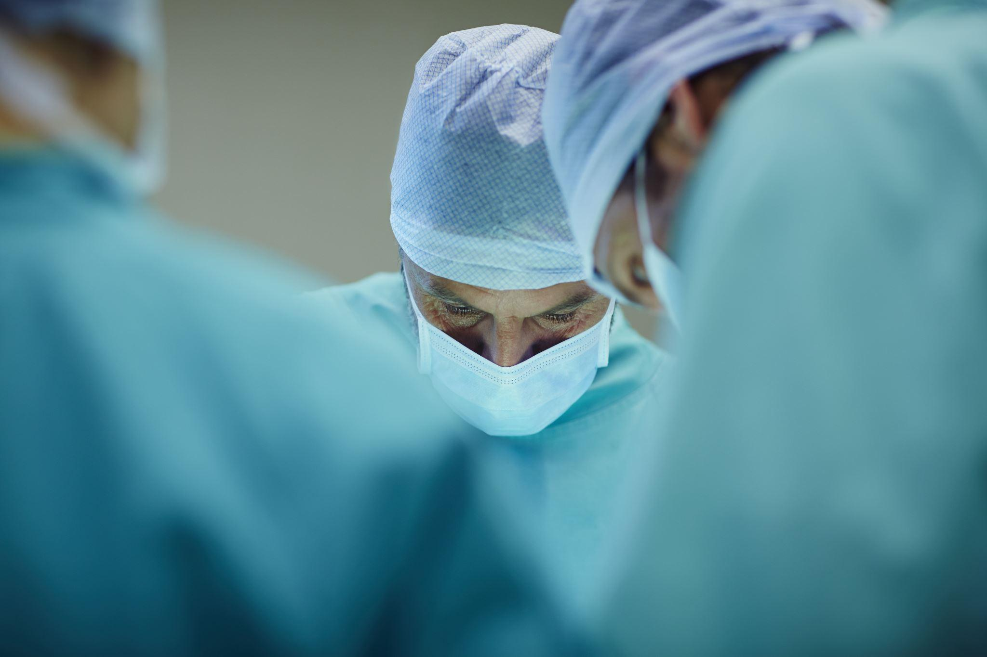

Specialty areas
HOSPITAL
NON-HOSPITAL
Hospital: Emergency, pediatrics, med/surg, ICU, L&D, OR, etc.
Non-hospital: Rehabilitation centers, nursing homes, clinics, private duty, legal nurse consultant, etc.
Notes:
Walk through a typical shift of your specialty
Real-life examples or stories (age-appropriate)
Skills: communication, time management, critical thinking
Emphasize core responsibilities (II) again along with teamwork and emotional resilience

Slide 5

Career outlook
Competitive salary and benefits
High demand and job stability
Opportunities for growth and specialization
Meaningful work: Making a difference every day
Flexible schedules (shifts, travel nursing, etc.)

Slide 6

Q&A/Discussion
Notes:
Interactive Skills Demonstration
BLS scenario: choking (Heimlich maneuver), CPR on mannequin, AED activation
Partnered assessment: pulses, auscultation of heart/lungs, pupil reactivity, manual BP
Equipment
Stethoscope
Manual BP cuff
Pulse oximeter
BLS mannequin
Pen light
AED
Nasal Cannula or other oxygen delivering equipment
Laryngoscope
Use time to answer questions and show equipment/skills as available

