Slide 2
FutuRN
By: American Association for Men in Nursing
Notes:
Click to add notes

Slide 3
What Are You Going To Be When You Grow Up?
Notes:
A classic relatable question
Opens up the conversation as to what people their age should consider when making a career decision
Allows the presenter to show how nursing fulfills these needs for many people
Some questions to ask the class:
Who here knows what they want to do? Who has no idea?
Who wants to work in healthcare? Doctors? Pharmacistis? Nurses?

Slide 4
Who Can Be a Nurse?
What Is a Nurse?
Notes:
Transition to the subject of the presentation after speaking openly with the class about the other careers they are considering. “Today I would like to give you some information about what the nursing profession has to offer.”
Ask class what they think of when they hear “nurse”
Traditionally, one of the few predominantly female professions
A constantly evolving profession
Many people picture a nurse as the person at the doctor’s office who takes your blood pressure before the doctor comes in. How many of you think of this when you think of nursing?

Slide 5
What to consider when selecting a career
Return on investment
Opportunity for advancement
Flexibility
4. Job security
5. Self-satisfaction
6. Meaningfulness
Notes:
No matter what career path you take, it most likely will require some form of an investment, most of often including time and money. If you’re looking to go to college, that will take years of school and a considerable amount of money. Starting a business takes risk, 7-day work weeks, and money. To be an artist, you need supplies and the opportunity to practice and create. Regardless of what you want, you will be making an investment and it is important to consider the risk/reward before committing to anything
Advancement: It’s important to keep in mind the opportunity to build on your experience and continue to grow as a professional. You want to be sure that whichever path you take, there is no ceiling for what you can do. Most people hope to be doing something different when they are 50 than what they are doing when they are 25. If you are one of these people, make certain that your chosen path allows for such opportunity.
Flexiiblity: Work/life balance is also something to keep in mind. Taking vacation, seeing family and raising children all come into conflict with job obligations. Therefore, you want to consider work that allows for these freedoms and can be easily amended to fit your outside goals.
As we saw in 2008, economic hardship happens from time to time. Unfortunately, natural market changes often cause cycles of layoffs and increasingly competitive job markets. Under such circumstances, you will want to be confident that your talent as a professional is not expendable and can endure changes in the job market. Further, after investing time and money in your chosen profession, the last thing you want is to be out of work.
Self satisfaction: They say “do something you love, and you’ll never have to work a day in your life.” While it may be difficult to understand now, realize that most people need to work until well into their 60s before they can afford to retire. If you are going to have to do something for 40+ years, you’ll want to make sure it is something you enjoy.
Similarly to enjoying the work you do, most people want to feel that what they do is important… feeling like you contribute something to society gives you a reason to wake up each morning and provides you with a sense of pride when you tell people what it is you do.

Slide 6
How Does Being a Nurse Meet These Needs?

Slide 7
Return on Investment
Well… what is the initial investment?

Slide 8
Education: Two Options to Begin Your Career
Associates Degree in Nursing (ADN)
2-year commitment
Technical colleges
Tuition is generally lower
Curriculum more nurse- focused
Bachelor's Degree in Nursing (BSN)
4-year commitment
Typically obtained from a university
Preferred degree for advance practice nurses and those with aspirations for graduate education
BOTH degrees are qualified for the same level of practice and earn the title Registered Nurse or “RN”
Notes:
Associates degrees in nursing are earned from 2-year institutions, usually technical colleges. Traditionally, these degrees are practice driven and allow students to enter the profession sooner and at a lower cost. Two to three years to complete this degree. Also, many hospitals pay for ADN-BSN bridge programs (however, the hospital decides where you go to school).
Bachelor’s degrees are earned from 4-year institutions, public and private. The BSN has a broader approach to teaching, providing students with a foundation in research, management, and teaching. A BSN is required for those seeking graduate school, and is the prefered degree of some hospitals -- especially major medical centers -- meaning certain hospitals will add a job postings “BSN preferred” or “BSN only” when looking for new employees. BSN holders average a slightly higher annual income compared with their ADN counterparts.

Slide 9
Return on Investment
Cost?
2-4 years of school x forecasted cost of tuition (varies substantially from program to program)
Salary: (use the link below and scroll down to see how your state compares)
https://nursesalaryguide.net/nurse-salary-by-state/
Notes:
This is a great opportunity for the presenter to click the link and show two local well-known schools to give students an idea of what they can expect. For example, a presenter in Wisconsin might show a tuition comparison between UW Madison, Marquette, and some local technical colleges.

Slide 10
How can I afford to go to school?
FAFSA
Scholarship
Attain certification as a Nurse’s Assistant
Broaden your professional network
Reevaluate what else you spend money on while in school
Begin saving BEFORE you go to college
Notes:
“How many of you are familiar with FAFSA? What can you tell us about it?”
FAFSA is a free application for students to show the government their family's financial situation and apply for loans and grants. Loans allow to students to pay for school with the expectation that they pay the government back. Grants are “free money” given to those who qualify. The application is free, it does not hurt anything to apply.
Scholarships: Scholarships are far more prevalent than many believe. Many scholarships go unawarded becasue nobody even applied for them. Take the time to write an essay and have a friend or family member read your application. Thousands of dollars could be given to you with no need to pay them back. Check with your work (and your parents’ work) for scholarship opportunities. Places you wouldn’t expect -- like Taco Bell and McDonalds -- offer scholarships to their employees who choose to go to college.
Working as a CNA allows you to get your feet wet in the field and learn the basics of nursing, and how to communicate with patients and their families.

Slide 11
2. Opportunity for Advancement
In nursing, the options for advancement and graduate work are endless.
Broadly speaking, there are three “groups” of graduate-level advancement
Professional RN certifications
Master’s level
Doctoral level

Slide 12
2. Opportunity for Advancement: Group 1
Professional Certifications:
Single class obligations
Usually involve a certification examination
Allow for “specialization” in the field
Benefits:
Increase pay
Networking within the specialized organization
More competitive for jobs
Notes:
Many companies offer their employees free certification classes to help them advance in their specialty. Major medical centers often try to maintain a “magnet” status, which is a nationally acclaimed certification for excellent nursing care, among other factors. In order to maintain magnet status, one requirement is a certain percentage of the working nurses must be specialized and credentialed as such.

Slide 13
Opportunities for Advancement: Group 1
Examples:
Trauma Certified Nurse (TCRN)
Sexual Assault Nurse Examiner (SANE)
Critical Care Nurse (CCRN)
Legal Nurse Consultant
Pediatric Advanced Life Support (PALS)

Slide 14
Opportunities for Advancement: Group 2
Masters level:
Require 2-3 years of graduate education
Allowed to teach at the college and university level
Preferred as a minimum qualification in areas of management and administration
Notes:
“Anyone here consider a career in teaching?” As a nurse, you can teach in addition to providing bedside care!

Slide 15
Opportunities for Advancement: Group 3
Doctoral Level:
Considered a “terminal degree”
Typically earned in 3-5 years from a university
Examples:
Doctor of Nursing Practice (DNP)- Administration
Doctor of Nursing Practice (DNP)- Clinical
Doctor of Philosophy in Nursing (PhD)- Researcher/Scientist
Certified Registered Nurse Anesthetist (CRNA)

Slide 16
Opportunities for Advancement: Group 4
Nurse Practitioner:
NPs prescribe medications, assess patients, diagnose illnesses, and provide treatments similar to a physician.
Bachelors in Nursing (BSN) is required for admission to NP schools
NP are required to obtain a master’s or doctorate in nursing practice.
N
Nurse Practitioner Salaries by specialty:
Family Nurse Practitioner: 85
Nurse Anesthesia: 153
Geriatrics: 95
Pysch: 91
Notes:
Nurse practitioners can choose many different specialties. Some of the most popular are:
Family nurse practitioner, who often works as a primary care provider to help maintain patients’ health and prevent diseases.
Acute care nurse practitioner, who works in hospital settings like emergency departments, ICUs, and surgical units to manage patients care for hospital stays.
Nurse anesthesia, who appropriately sedate patients for procedures.
Geriatrics, where the focus is providing health care to our aging population.

Slide 17
Limitless opportunity!
Notes:
Take this time to talk about your credentials and career aspirations, areas of nursing you are familiar with, and your thoughts on various graduate degrees

Slide 18
3. Flexibility
Shift options often include 4-, 8-, 10-, or 12-hour work days
Wage earner vs. salary
Opportunity for overtime
Opportunity to work 1st, 2nd,
and 3rd shifts
Working 12-hour shifts allows nurses to work only 3 days a week and have 4 days off.

Slide 19
3. Flexibility
Common nursing specialties:
Medical/Surgical nursing: Largest nursing specialty that cares for stable, acutely ill, and deteriorating patients.
Intensive care units: Provide care for life threatening medical conditions for patients that are considered too unstable for other units.
Neonatal intensive care unit: Cares for newborns that need extra medical attention due to prematurity, congenital diseases, or other health ailments.
Notes:
Medical Surgical: This is the most common spot for new graduate nurses as it provides a solid base for ones nursing career.
Intensive Care Units: Many ICUs are specialized in what they treat some examples are trauma ICU, pediatric ICU, cardiac ICU, neuro ICU, surgical ICU
Neonatal Intensive care unit: Some patients are smaller than your hand and weigh 1 pound.

Slide 20
3. Flexibility
Obstetrics
Research
Insurance and medical technology representative
Critical Care
Operating Room
Sexual Assault Examiner/ Forensic Nurse
Nurse Attorney
Dialysis Nurse
Disaster Relief
Professor
Coroner
Pediatrics
Cruise ship nursing
Correctional
Mental health
… and so much more!
Consider your interests and find something you love:
Medical/Surgical Nursing
Emergency/Trauma Nursing
Nurse Administration
Chief Nursing Officer
Flight Nursing
Travel Nursing
School Nurse
Hospice and end of life
Cath lab
Military Nursing
Occupational Health
Notes:
Take a moment to appreciate all these different lines of work, most of which are available new grades and require little to no extra education. If you should ever find yourself dissatisfied with your current job as a nurse, you can be certain that there is something better in store for you if you are willing to look.

Slide 21
Spotlight Nursing Job: Travel Nursing
Local, regional and national opportunities for travel
Contract- based employment
Chance to work within multiple hospital systems
Significant pay increase
Often reimbursed for living expenses
Notes:
Travel nursing is for nurses with at least one year of experience with two years prefered for most hospitals.
Contracts for hospitals typically last 13 weeks. Nurses are often offered the option to extend their contract or can work with their recruiter to find a new place.
Travel nurses typically make somewhere between $1,500 to $2,000 a week after taxes. Housing costs are covered, as well as living expenses, classes, and license renewal.
Being a travel nurse allows you to explore the country and work in different cities while receiving a large increase in pay.

Slide 22
Spotlight Nursing Job: Flight Nursing
Highly autonomous practice
Often able to work outside of practice scope in emergent scenarios
Transfer vital organs for transplant, critical patients to higher levels of care, as well as many other exciting opportunities
Notes:
Flight nurses work to transfer patients in critical situations via helicopter.

Slide 23
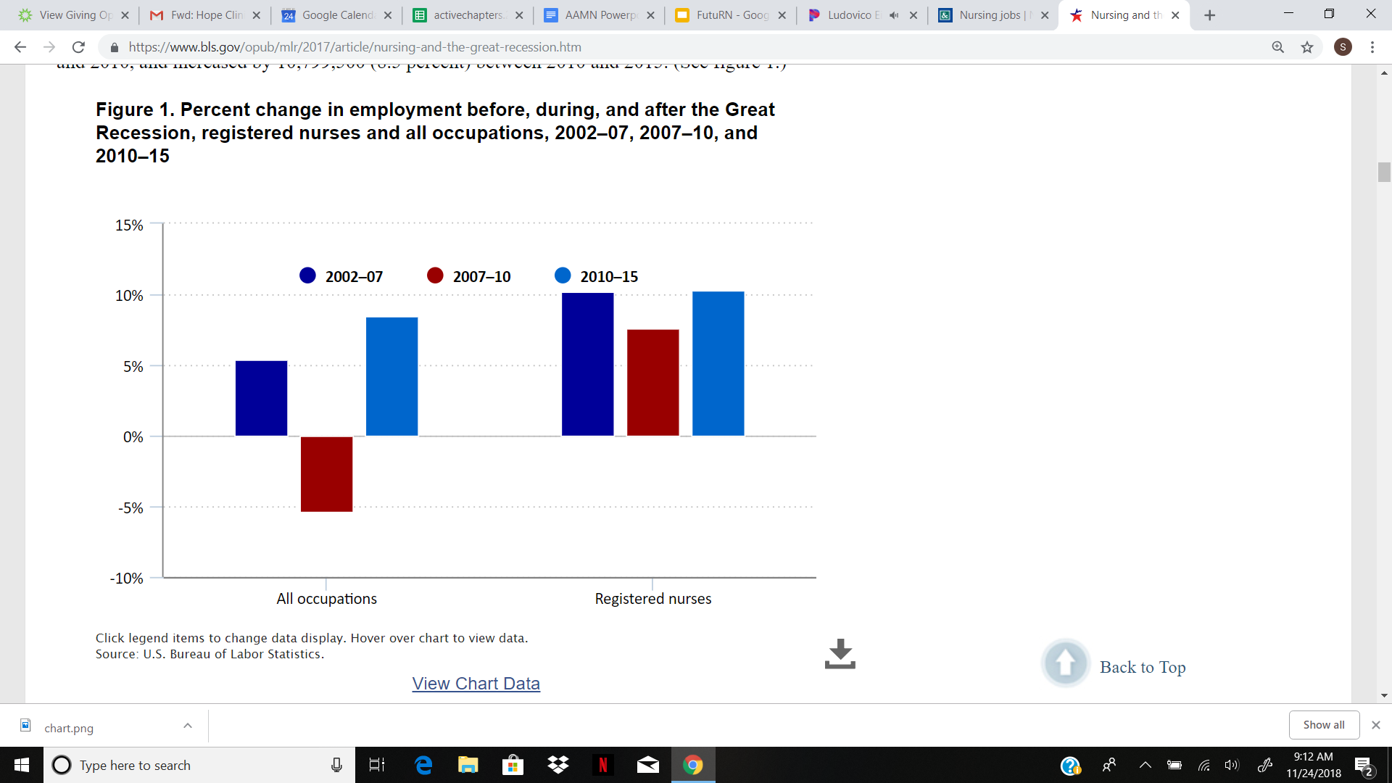
4. Job Security
Obsoletism: Can technology replace bedside care
Human life: As long as people are capable of sickness and death, there will be a need for nurses
Baby Boomers and the forecasted
impact on healthcare
Current unemployment rate of 1.2%
Notes:
Source of Chart: https://www.bls.gov/opub/mlr/2017/article/nursing-and-the-great-recession.htm
Lots of information on the link above relating to nursing and the great recession from the Bureau of Labor Statistics
**If this image should be removed for citation reasons, we should include this link for presenters to refer to during the presentation

Slide 24
5. Self Satisfaction
So how do I know which area is right for me?
Consider where you feel comfortable
What population do you “connect” with?
What are your strengths? Weaknesses? How do those help and hinder your work in a particular area
**If you’re interested, contact your local hospital and coordinate a job shadow experience

Slide 25
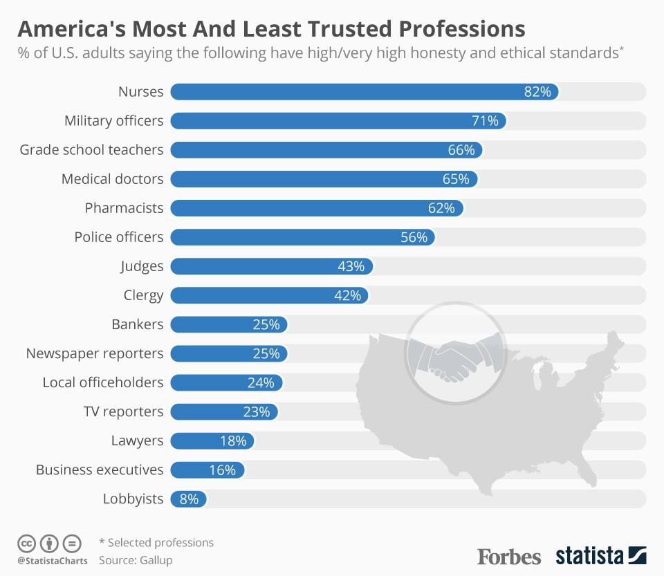
6. Meaningfulness
Consistently recognized as the most trusted profession
Seeing people at their most vulnerable
Witnessing things each day that most people seldom see elsewhere

Slide 26
Professional Associations
American Association for Men in Nursing (AAMN)
Mission Statement: To shape the practice, education, research, and leadership for men in nursing and advance men’s health.
Currently, males comprise 7-9% of the nursing profession
Notes:
Introduce yourself as a member and discuss your experience with a professional organization
Professional organizations are important to the nursing fields because they allow nursing professionals (and students) to network with others in the field. This creates meaningful communication to allow for the exchange of ideas and networking can lead to professional advancement.

Slide 27
Professional Associations
American Nurses Association (ANA)
Nurses advancing our profession to improve health for all.
National Black Nurses Association (NBNA)
Represent and provide a forum for black nurses to advocate and implement strategies to ensure access to the highest quality of healthcare for persons of color.
Academy of Medical Surgical Nurses (AMSN)
Fosters the highest standards of practice, advances nursing practice guidelines, and promotes excellence in medical- surgical nursing.
Quotes for illustration purposes only
Notes:
Professional nursing organizations range in focus from very broad -- like the ANA -- to specializing in an ethnicity, like the NBNA, to unit or specialty of care focused. Odds are there is an organization out there that fits your passion.

Slide 28
Professional Associations Continued...
Sigma Theta Tau International
“Sigma's mission is advancing world health and celebrating nursing excellence in scholarship, leadership, and service.”
American Association of Colleges of Nursing
“As the collective voice for academic nursing, AACN serves as the catalyst for excellence and innovation in nursing education, research, and practice.”
National League of Nursing
“The National League for Nursing promotes excellence in nursing education to build a strong and diverse nursing workforce to advance the health of our nation and the global community.”

Slide 29
What Can I Do Now?
Certified Nursing Assistant, Patient Care Tech, Medical Tech
Get Involved in Research
Set Up a Job Shadow
Link up with a Mentor
Notes:
CNA, PCA, UAP and MT certifications will allow you to work alongside medical professions and get first hand experience.
What better way to determine if this field is right for you then working as a nurse’s assistant?
Age of eligibility to be a CNA varies from state to state
Generally pays better than most high school level jobs
Job shadowing will let you follow a nurse and see what they do on a day to day basis. Job shadowing can also help you see which units you’d be interested in.
Nursing programs are extremely competitive for admission. Stay on top of your GPA in college, and do something to set yourself apart from other applicants.

Slide 30
Questions?
Contact _____(Presenter)_______
Questions related to Professional Organizations can be directed to:
info@aamn.org
Notes:
Offer some time to take questions in front of the class.

Slide 31
Thank you!

